Slide 1



Covid update
View in Power BI
Last data refresh:
7/25/2022 7:40:30 PM UTC
Downloaded at:
9/13/2022 7:39:33 AM UTC

Slide 2
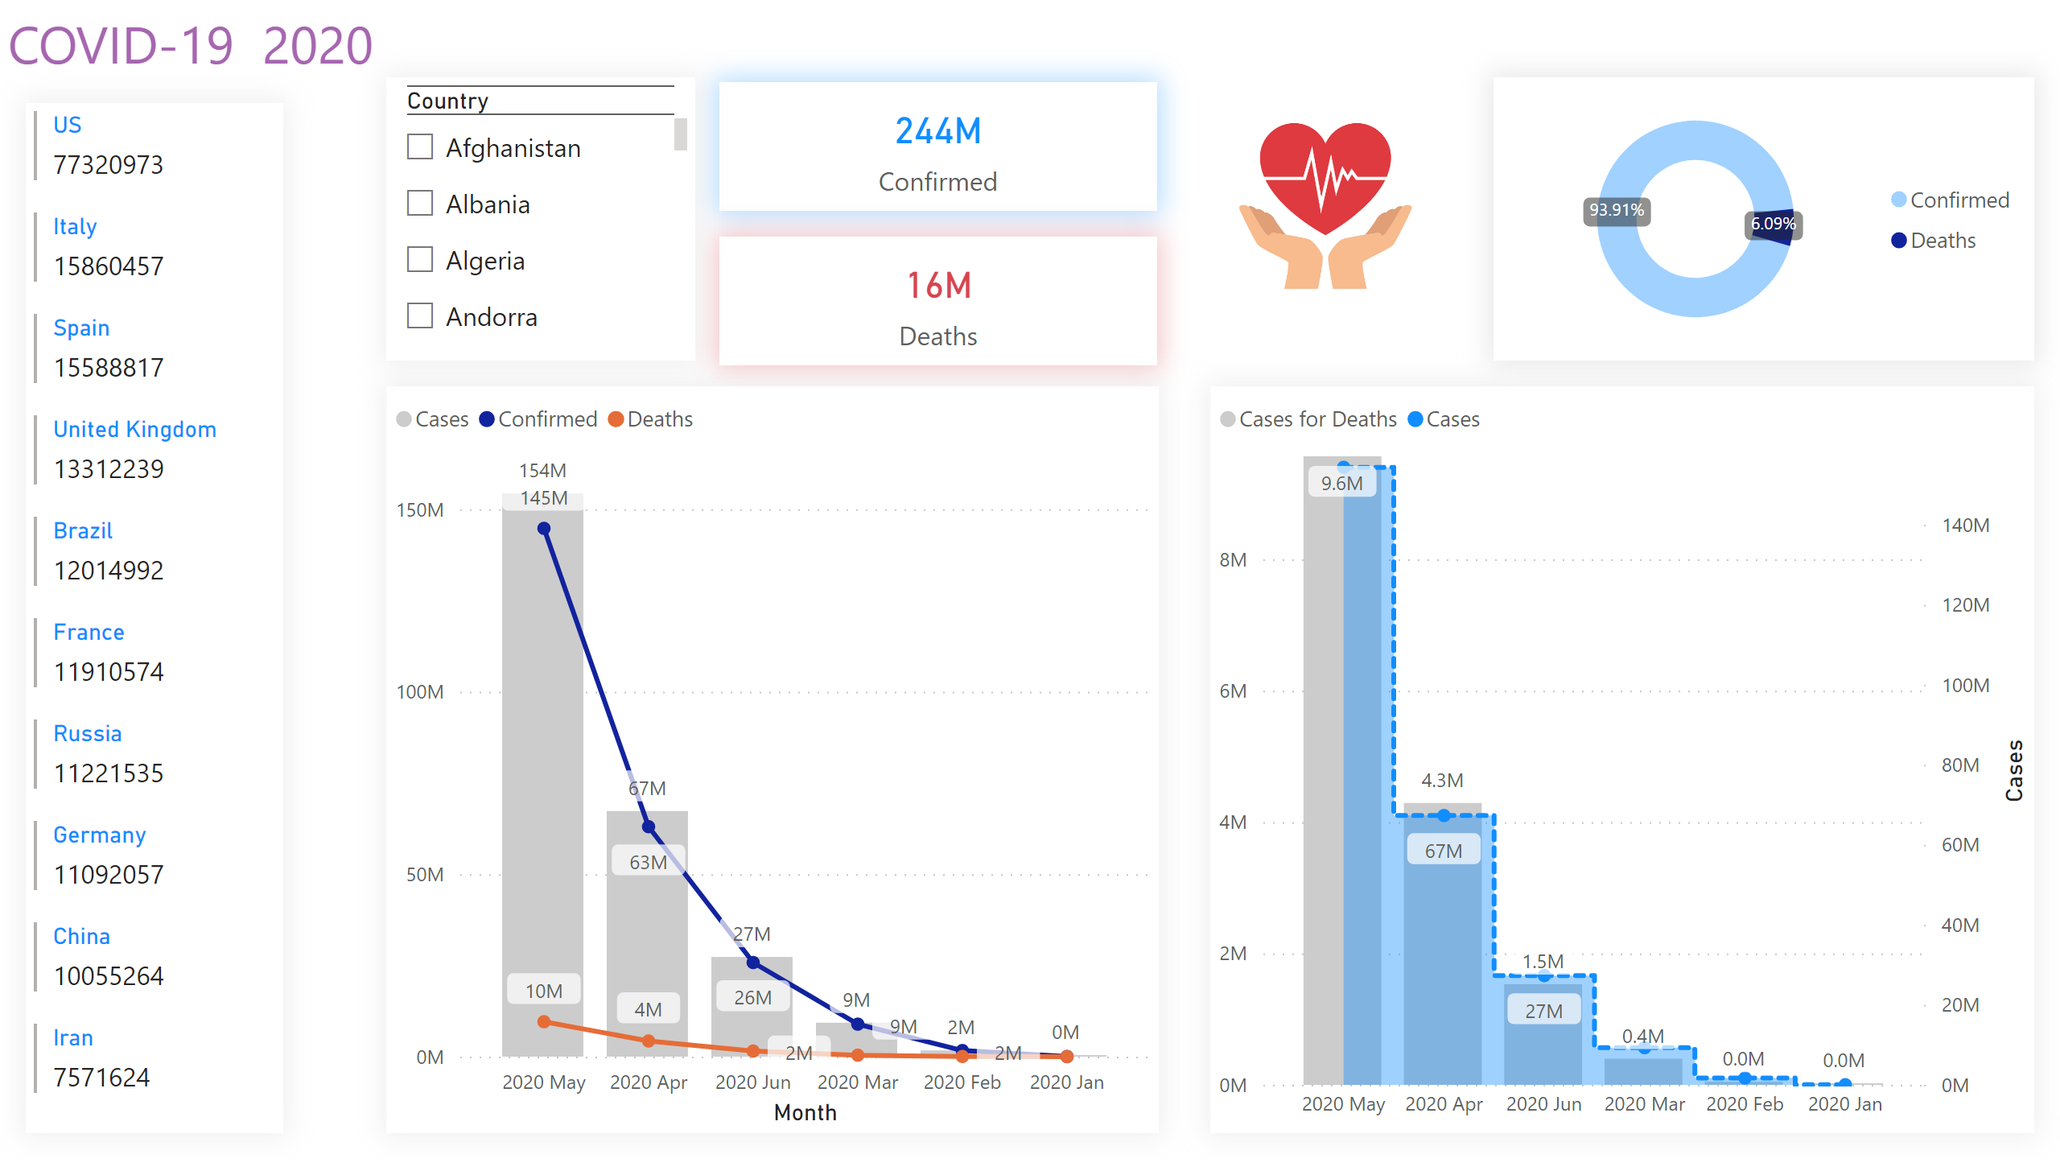
Dasheboard
Notes:
card
No alt text provided
card
No alt text provided
multiRowCard
No alt text provided
lineClusteredColumnComboChart
No alt text provided
lineClusteredColumnComboChart
No alt text provided
donutChart
No alt text provided
image
No alt text provided
textbox
No alt text provided
slicer
No alt text provided

Slide 3
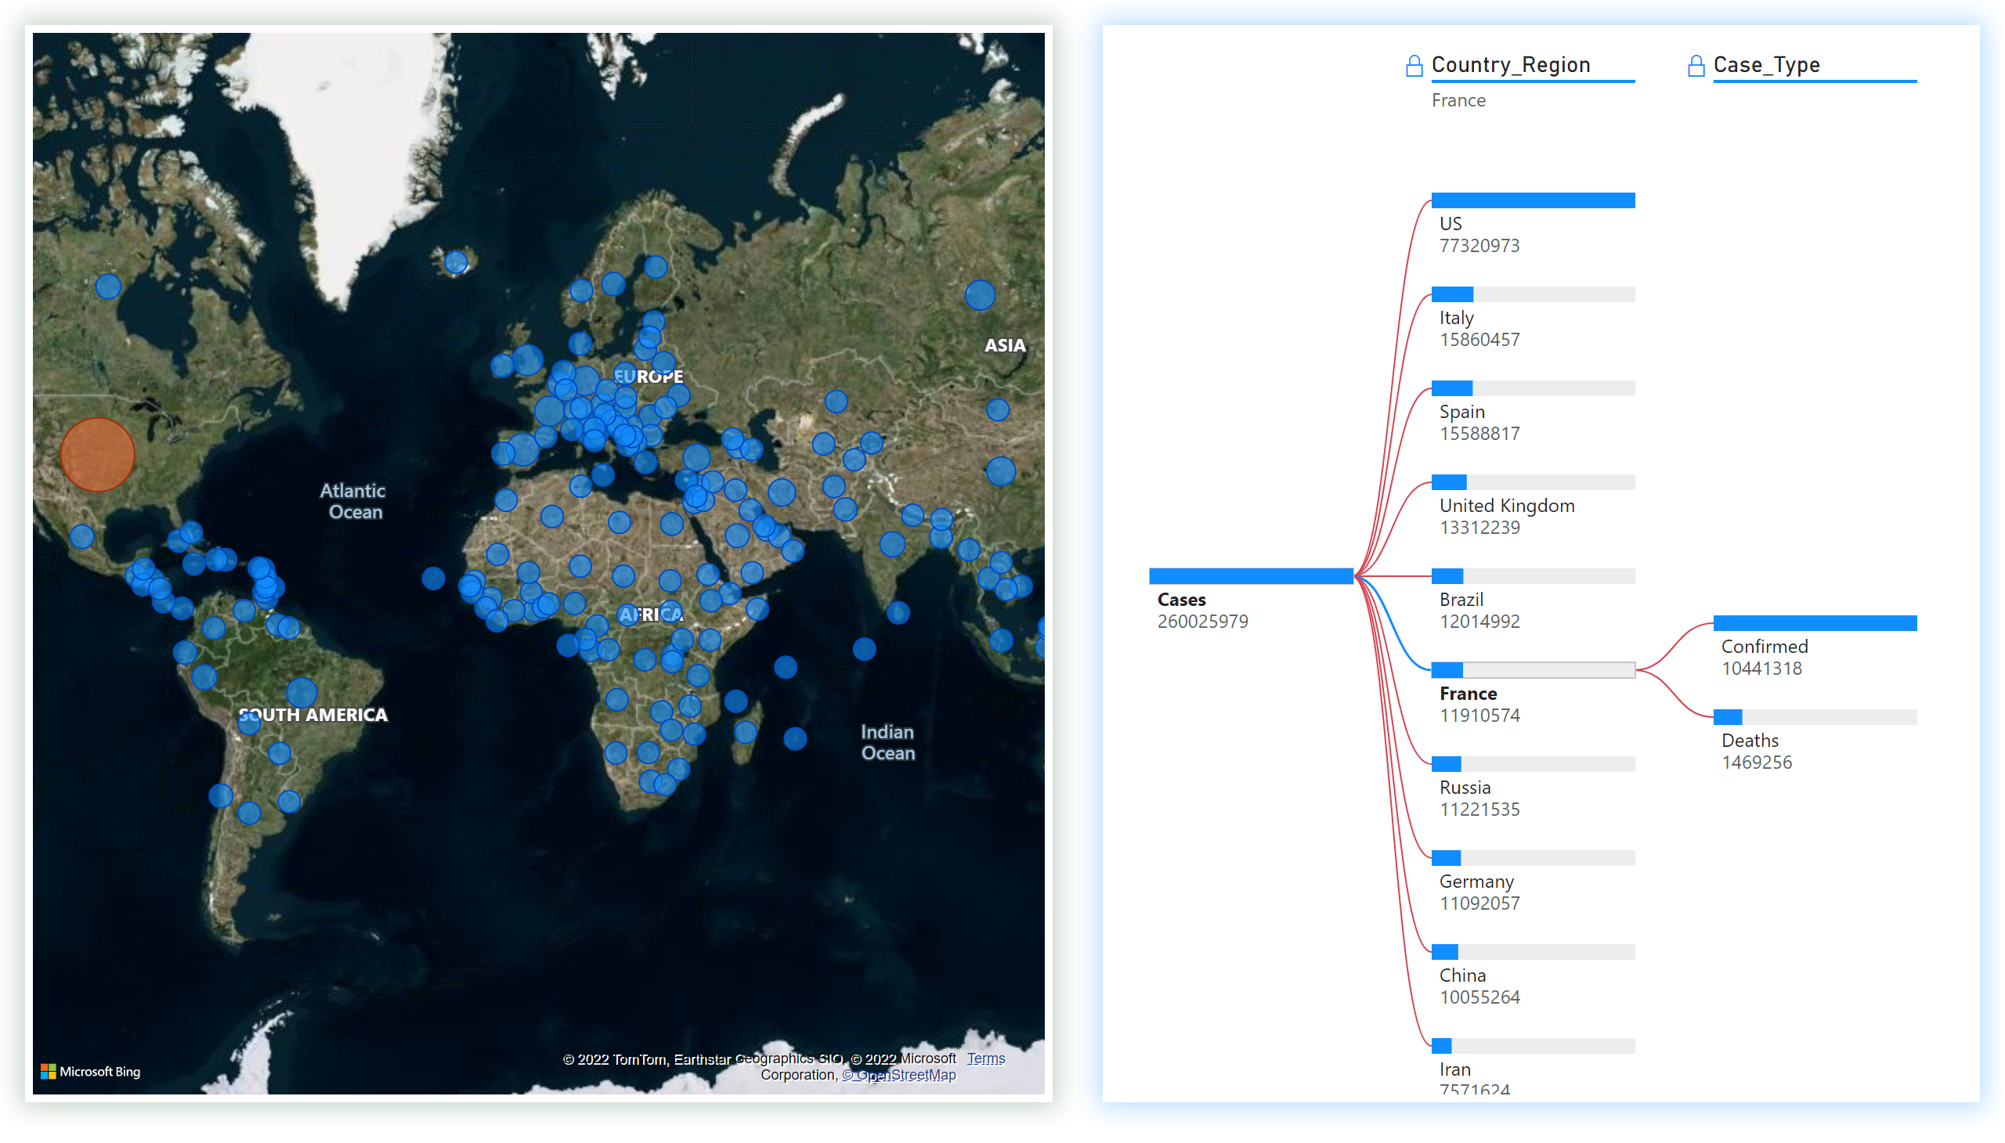
Tree
Notes:
decompositionTreeVisual
No alt text provided
map
No alt text provided

Slide 4
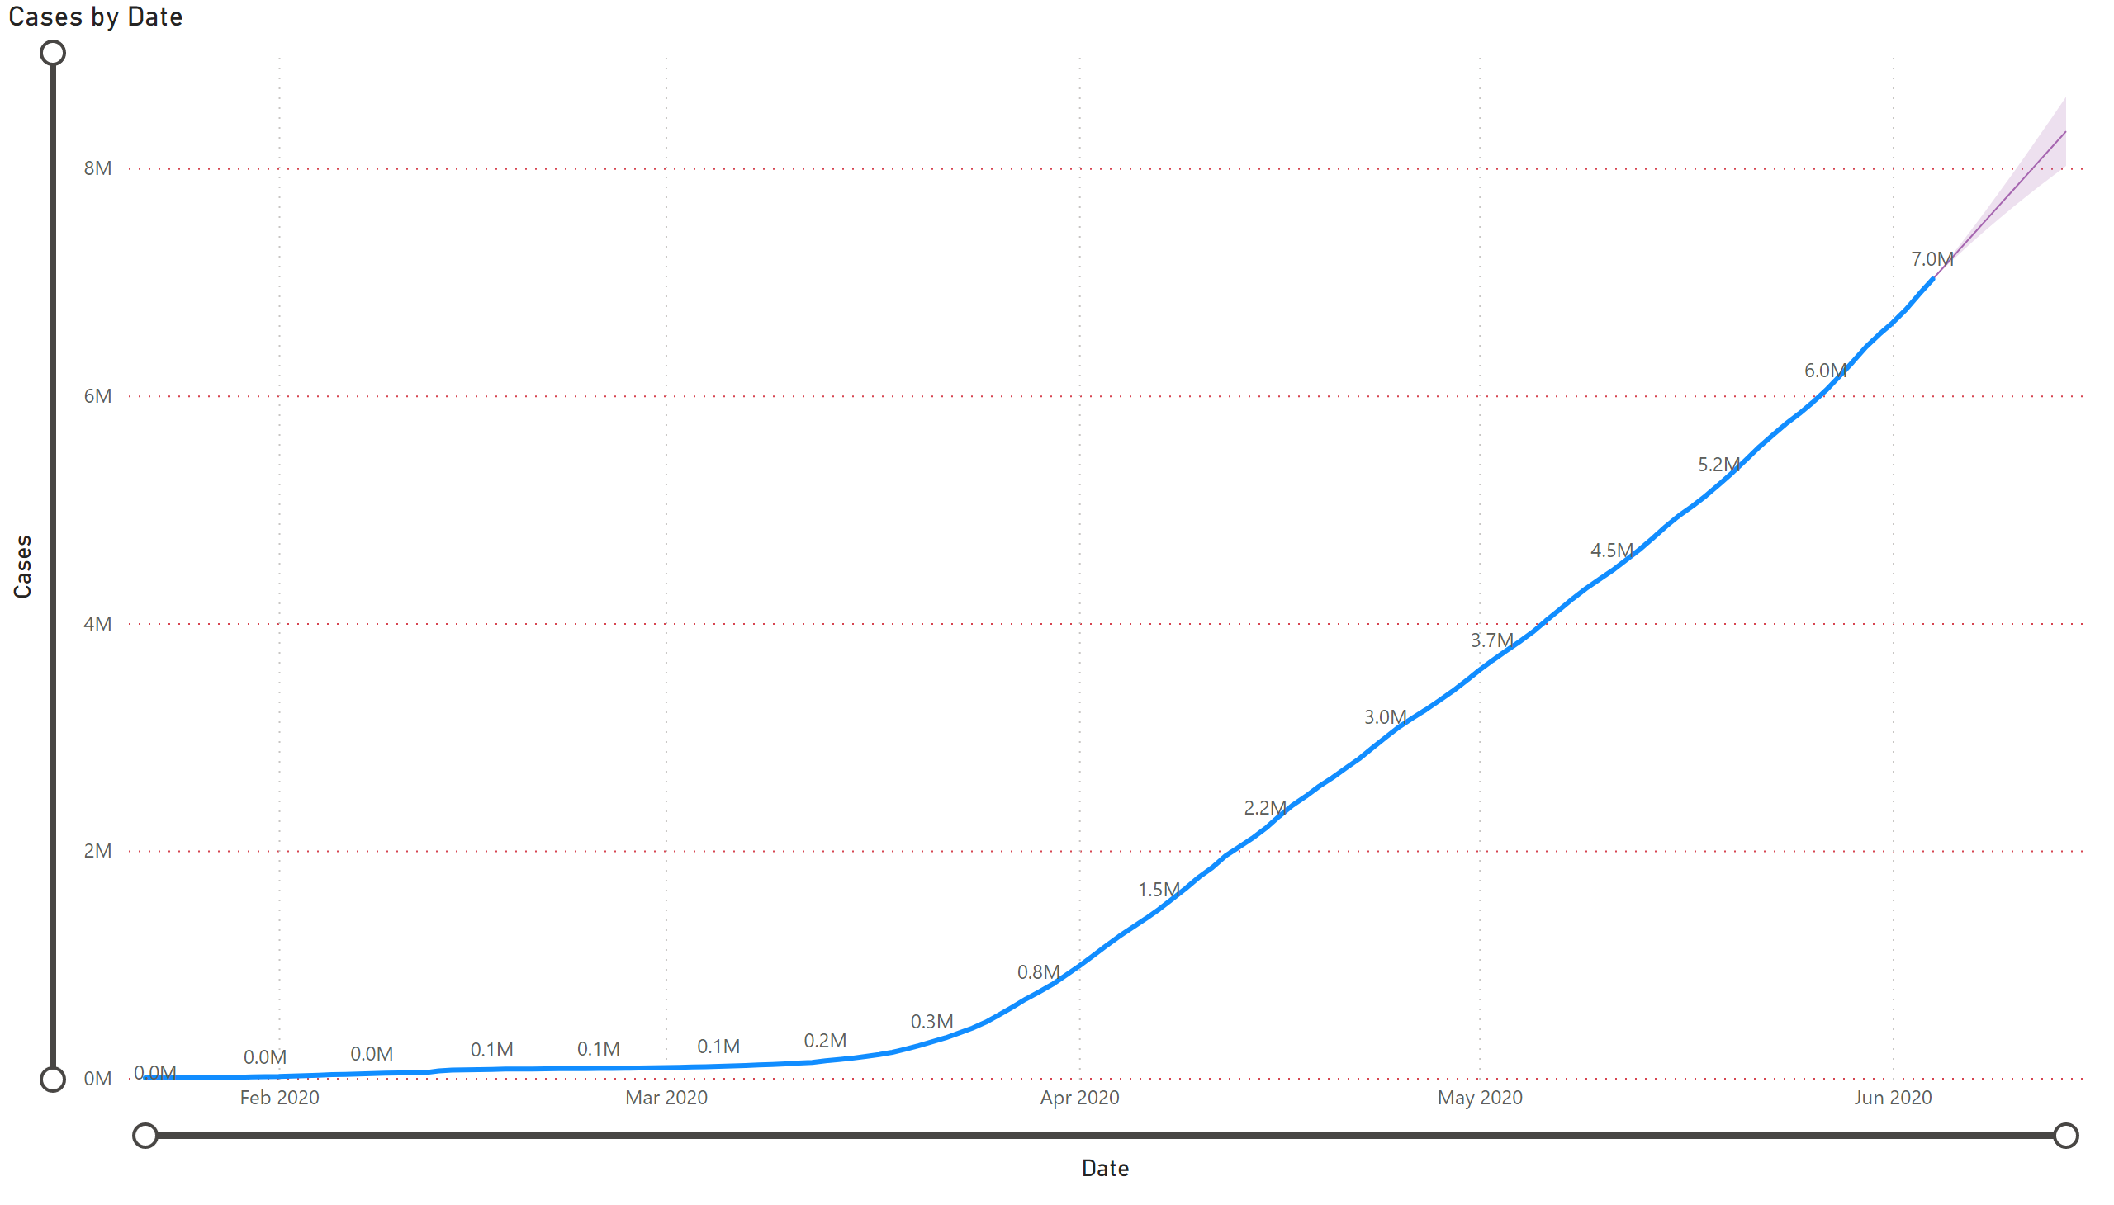
Forecast
Notes:
lineChart
No alt text provided

